Slide 1
The Systems Team Update
Parker McLeod and Cory Brynds
02/02/2024

Slide 2
Progress Overview
Parker
Cleaned Up CodeBase
Implemented Per-Function Performance Metrics
Prepared Demo
Cory
Parsed initial CSV output data to extract input features and output labels
Developed an initial three-level regression neural network
Trained network on ~90 data points
Tested input values, promising first prediction results

Slide 3
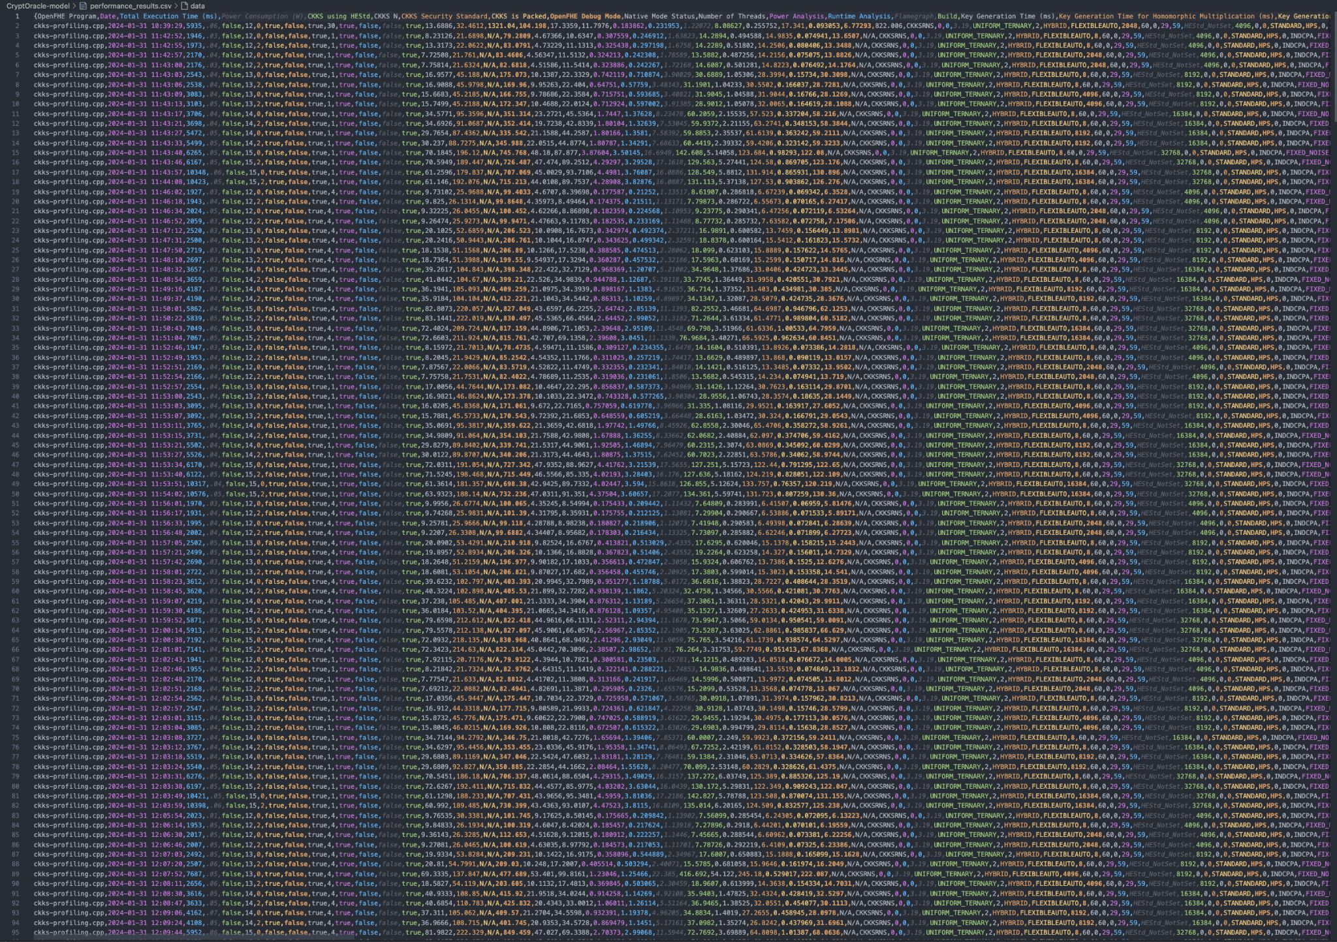
CryptOracle: the PyTorch Model
Multi-output regression model
4 Input Features:
Ciphertext Ring Dimension (N)
Security Standard (128, 192, 256-bit)
Sparse or Packed Ciphertext (true/false)
Number of Threads
15 Output Features (Currently):
Total runtime
Power consumption
Key generation time (all keys)
Computation time (add, multiply, rotate)
Bootstrapping time
Multi-output regression neural network

Slide 4
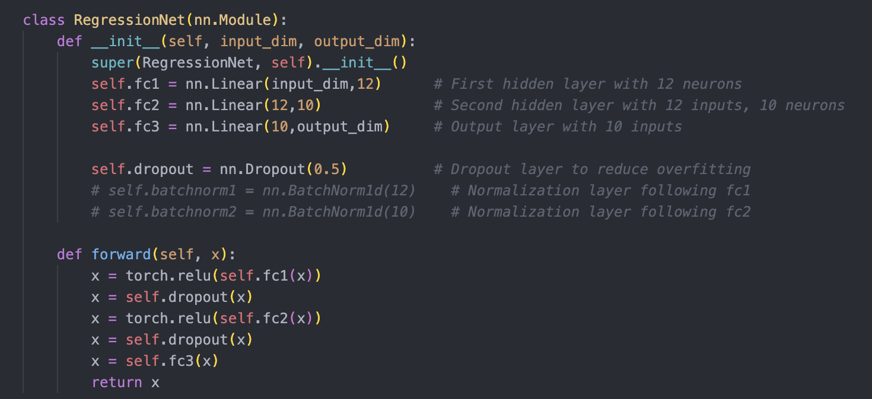
Model Settings
Model settings ->
Training data:
~90 data points, collected using parameter generation script
Testing data:
~7 data points

Slide 5
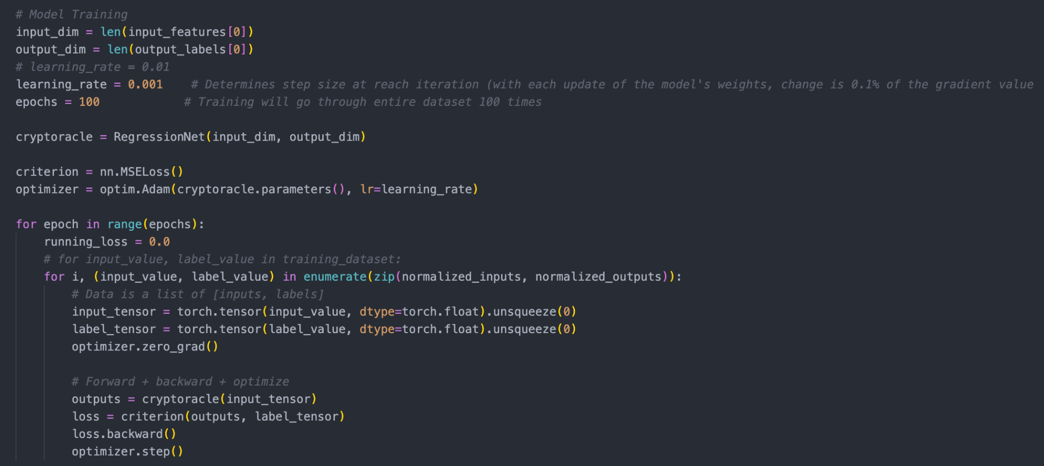
Model Training
First, we normalize!

Slide 6
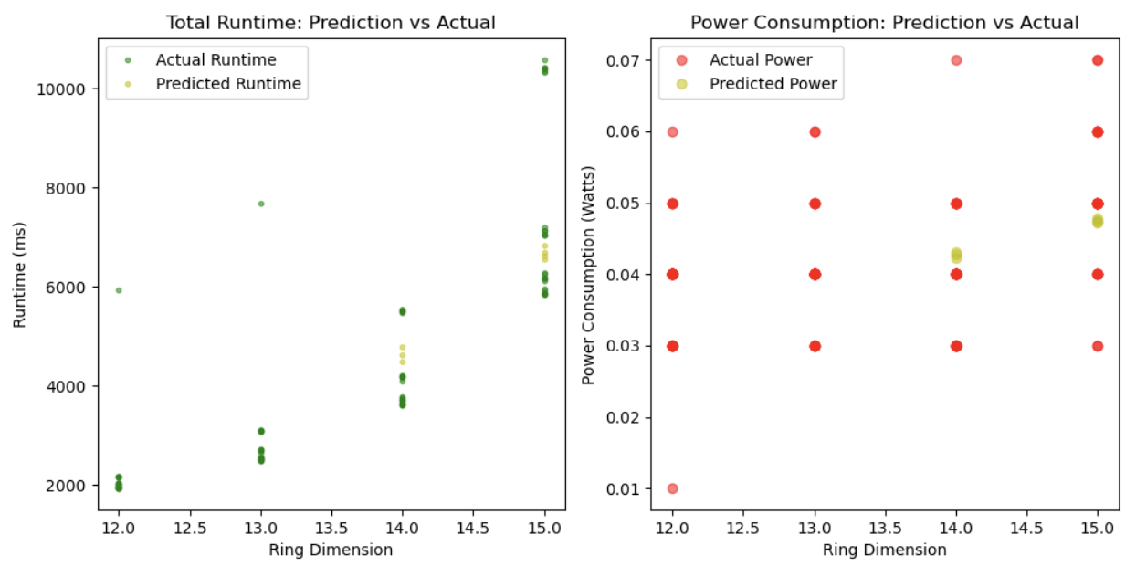
Model Prediction
*Note: although ring dimension is the only input parameter showed, outputs reflect all input parameters

Slide 7
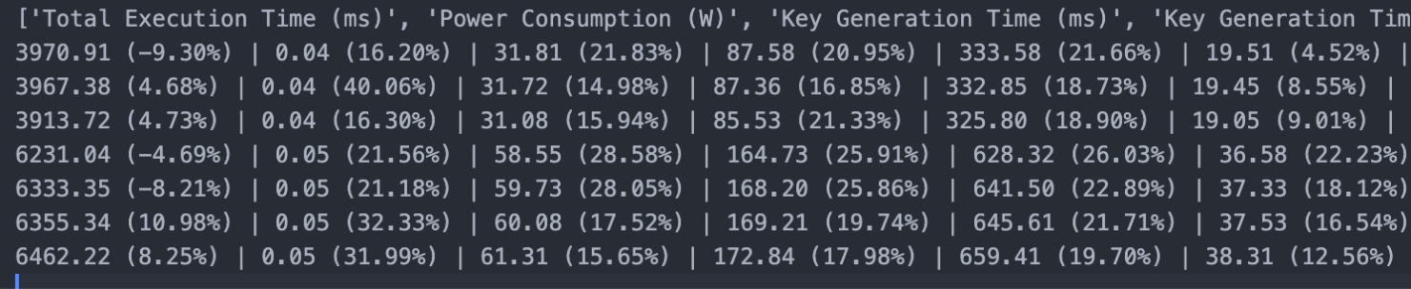
Prediction Error
Initial prediction error rates, need to fine-tune model and training data

Slide 8
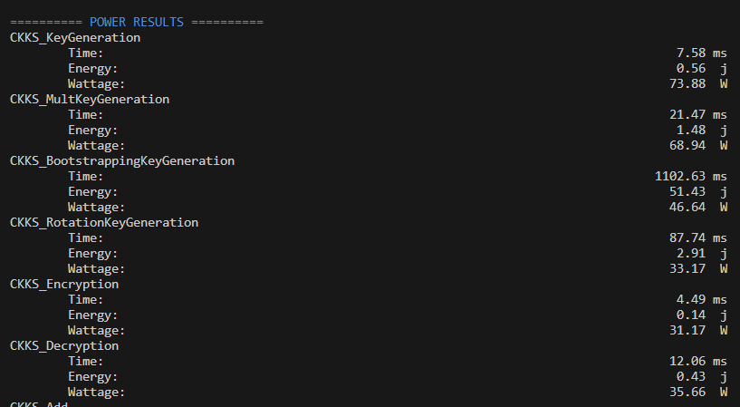
Metric Gathering
Completed Per Operation
Latency
Power
In Progress Per Operation
L1/LLC Instruction/Data Cache Loads/Stores and Misses
Branch Loads and Misses
Average CPU Utilization
DRAM Bandwidth Use and Estimated Waiting Cycles

Slide 9
Metric Gathering Continued
TODO Per Operation
Valgrind Memory Usage
Arithmetic Intensity
TODO Total
Hardware Data

Slide 10
Implement Multiple Function Calls Per Operation
Power and Perf polling too fast! Functions faster than 1ms!
Discuss how to approach this with hot vs cold cache group discussion!

Slide 11
Demo Discussion
Overview of Project Inspirations
Overview of Project Goals
Overview of Current Development Status
Demonstration of Current Program
Discuss Future Work and Dates
(Send to Rex? Send YArch Paper?)

Slide 12

Next Steps for the Systems Team
Next Steps
Gather larger dataset
Improve initial neural network performance
Parse Valgrind for memory usage per fundamental operation
Collect Bandwidth Utilization/Environment (cpu, memory, cache) information
Arithmetic intensity calculations
Share demo and/or data with Rex alongside a program diagram (and access to more processing power / varied CPUs)
Implement Multiple Function Calls Per Operation

